Slide 1
A Collection of ‘Tails’ from a Public Health Veterinarian
March 2021
Hugh Mainzer, MS, DVM, DACVPM
Views are those of the presenter and may not necessarily represent official policies and programs of CDC/ATSDR or the US Department of Health and Human Services.

Slide 2
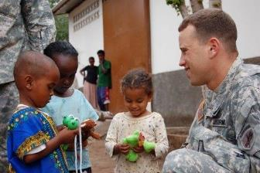
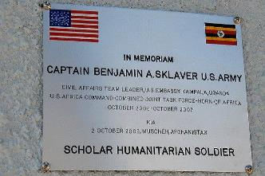

Slide 3

Definition of ‘disaster’
A sudden calamitous event bringing great damage, loss, or destruction
https://www.merriam-webster.com/dictionary/disaster

Slide 4


Slide 5

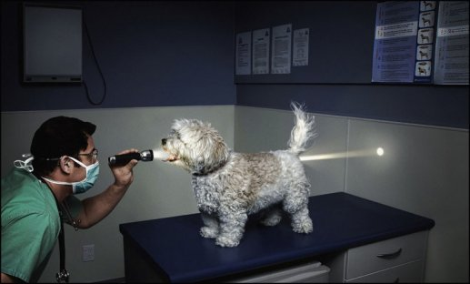
Myths and Misinformation

Slide 6
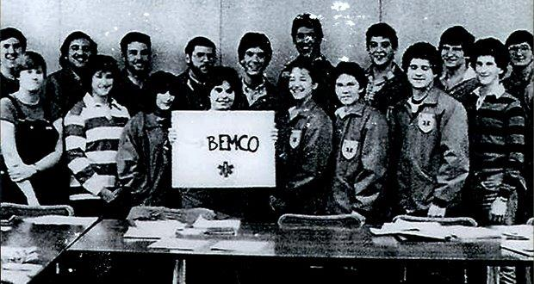
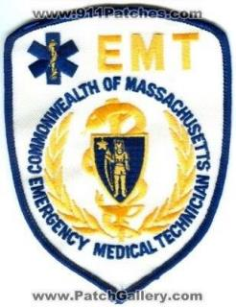

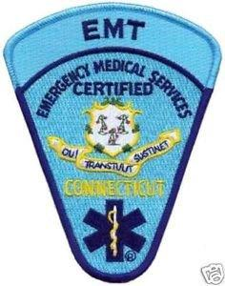
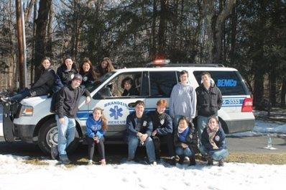

Slide 7
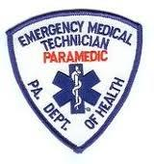
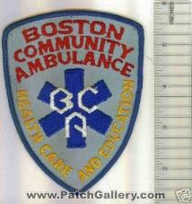
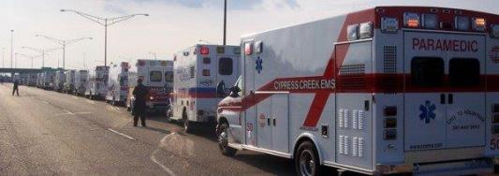
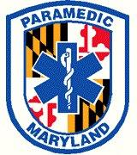
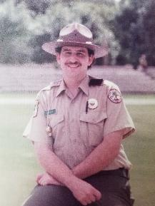
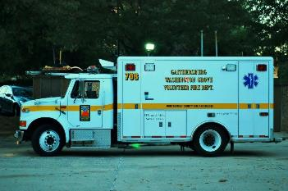
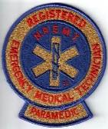
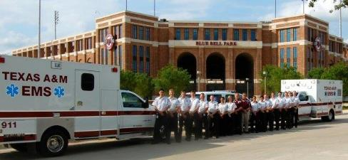
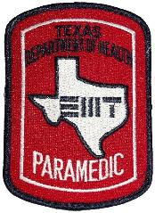
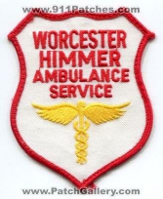

Slide 8
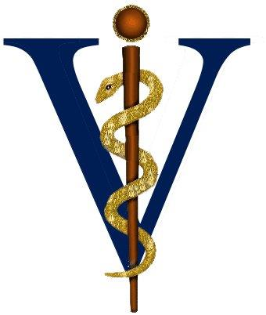

Slide 9
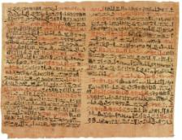
But I am a clinician…
I already care .. All of the time
But, are we meeting the full range of health needs of our patients?..Our partners?...The community? ..Our planet?
Superior doctors prevent the disease.
Mediocre doctors treat the disease before evident.
Inferior doctors treat the full blown disease.
Huang Dee: Nai-Ching
(2600 B.C., 1st Chinese Medical Text)

Slide 10
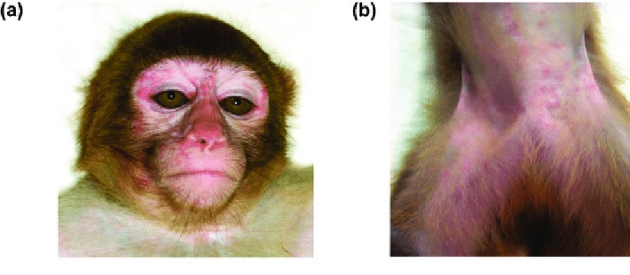

Slide 11
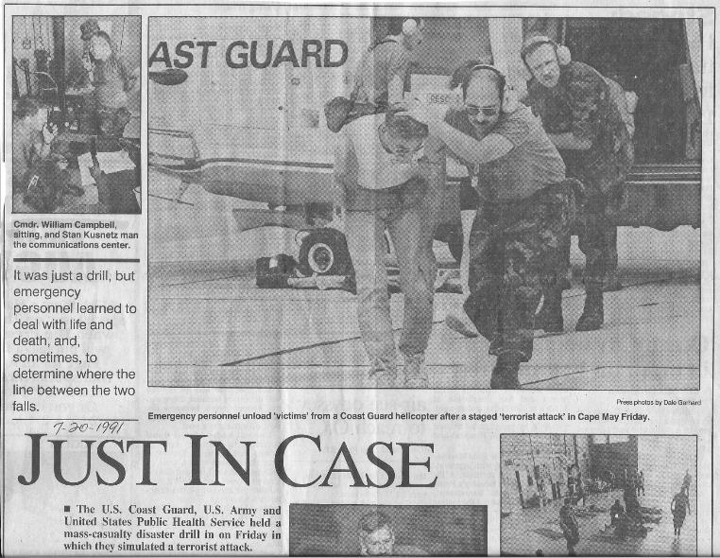
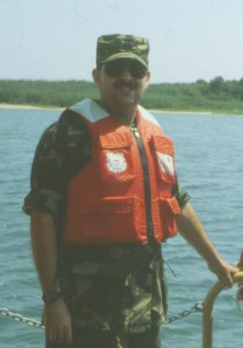

Slide 12

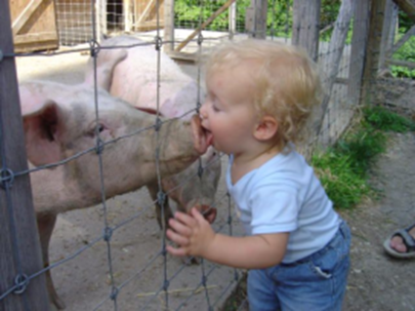

ONE HEALTH
One Health is the collaborative effort of multiple disciplines – working locally, nationally and globally - to attain optimal well-being of humans, animals and our environment.

Slide 13
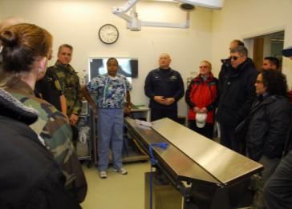
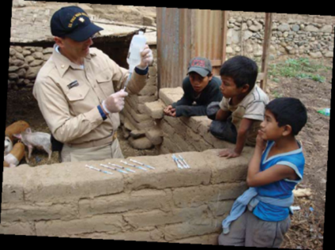
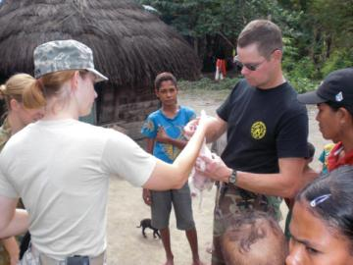
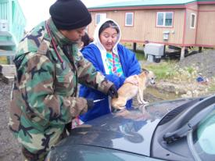
Health Diplomacy- Veterinary Medicine An “All Health” Team
Notes:
13

Slide 14
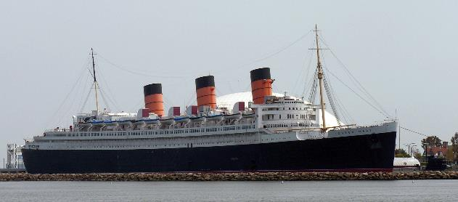
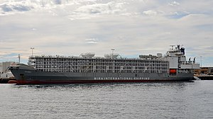

Slide 15
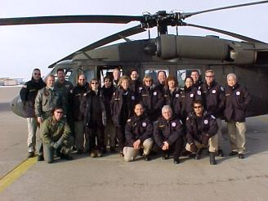
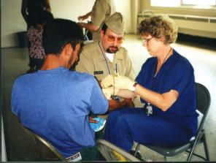
Emerging Health Competencies for All Health Professionals
Terrorism-General principles/scenarios related to intentional acts involving biologics, chemicals, radioactivity, and/or explosive devices
Natural/technological Disasters- General principles impacting human populations from naturally occurring or unintentionally caused events.
Environmental Health Systems- esp Water, food, sanitation, shelter .
Occupational Health and Safety.
Mental and Behavioral Health
Pre-hospital emergency response skills .
Regulatory issues

Slide 16
All-Hazards Approach
Science
Biological
Service
Nuclear/
Radiological
Chemical
Trauma/Nat’l.
Disasters
Systems

Slide 17






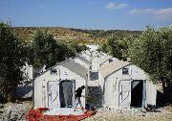



The Priorities

Slide 18
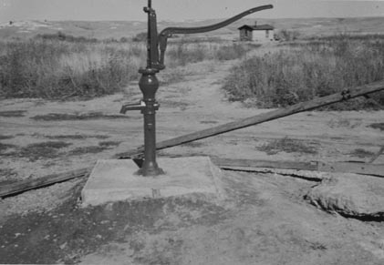


Slide 19
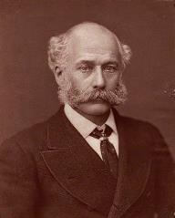
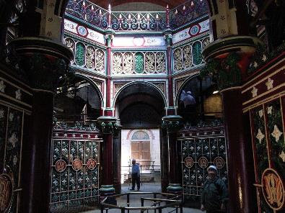
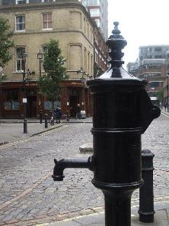
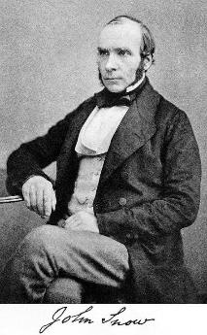
Sir Joseph Bazalgette
By Lock & Whitfield - National Portrait Gallery, London, Public Domain
Notes:
From - https://www.history.co.uk/history-of-london/sir-joseph-bazalgette-and-londons-sewers
Imagine the smell that three million Londoners could make if their toilets poured into overflowing cesspools or drains in the street, or if they emptied chamberpots out of their windows. It's unthinkable now, but that was reality in 1855.
By the middle of the nineteenth century, the Victorians knew this wasn't healthy, but not why. When Queen Victoria came to the throne, only half of London's infants lived to their fifth birthday. Diseases such as cholera were rife in the capital.
The first recorded case of cholera in England was in Newcastle in 1831, and there were major outbreaks in 1849 and 1854. But there was no cure and no treatment. Since Roman times, it had been thought that diseases like malaria – and, by extension, cholera – were spread in the air by 'miasmas' or terrible smells. This was why the Romans had built sewers – to get rid of the smells, not the sewage.
It took some clever deduction by Dr John Snow, later immortalised at a Soho pub, to find the true cause. Having attended many patients during the 1849 outbreak without contracting cholera himself, he realised that it could not be transmitted through the air. Then, the pattern of an outbreak in 1854 in Soho allowed him to track the source to a popular water pump in Broad Street (now Broadwick Street). Particularly telling was the fact that none of the 70 workers in the local brewery died, as they only drank beer.
Although Snow was unaware of it, a sewer was leaking into the Broad Street well. Sadly, such cross contamination between the sewage system and water supplies was typical. Only when the problem was literally forced up the noses of MPs at their new Houses of Parliament during the 'Great Stink' in the summer of 1858 did something get done about it. Parliament gave £3 million to the Metropolitan Board of Works to sort out the problem. The task was taken on by chief engineer Joseph Bazalgette, who designed and constructed five major brick-lined sewers measuring 132 km (82 miles); three north of the river and two to the south. These connected with existing sewers and pumping stations were built at strategic locations to keep the sewage flowing.
Bazalgette's sewers are partly hidden beneath the vast embankments alongside the Thames, including the Victoria and Albert Embankments. These changed the shape of the river and you can still see stranded water gates at various points that mark its original edge.
Building London's sewers was the biggest civil engineering project in the world at the time. Sadly, delays to allow the embankments to also house new Underground lines meant that a final cholera epidemic hit London in 1866. The sewers were completed around 1870, with two extra sewers added about 1910. Still in use today, they can handle up to 1.8 billion litres (400 million gallons) of sewage a day. Although they are in great need of repair and replacement, London without them is unthinkable.

Slide 20
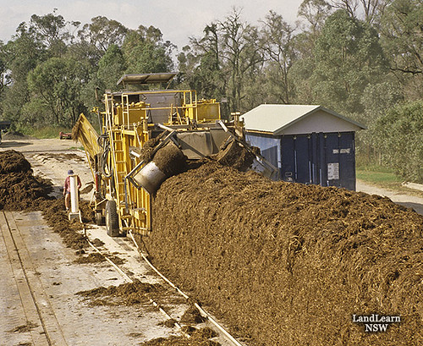

Slide 21
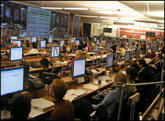
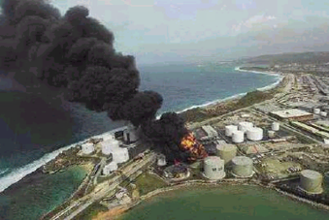

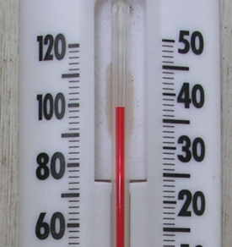
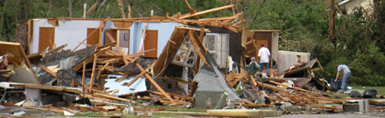

Slide 22
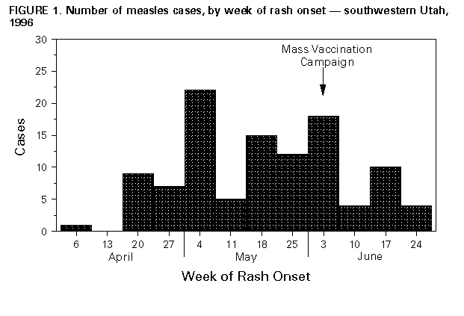
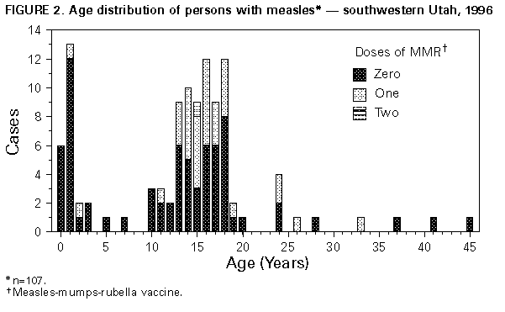

Slide 23


Slide 24
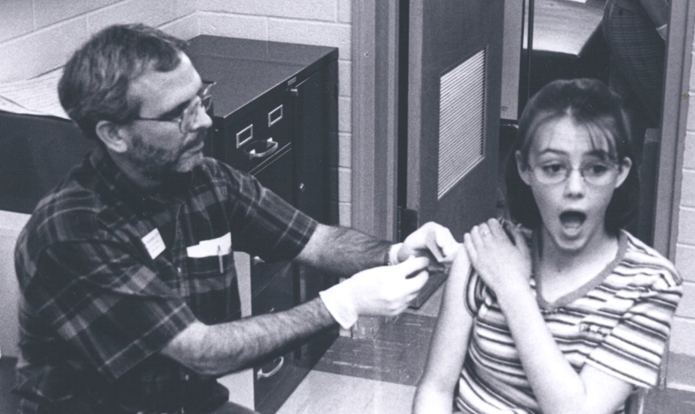
Presented with prior permission: from The Riverton Ranger. Oct 1, 1998. p 1
Photographer: Wayne Nicholls

Slide 25
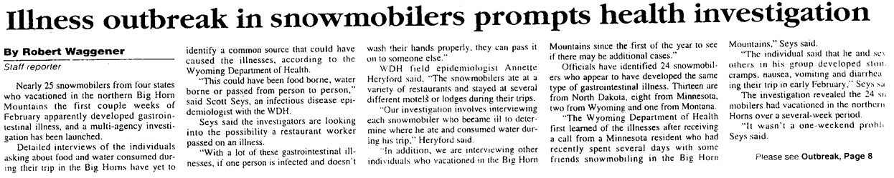
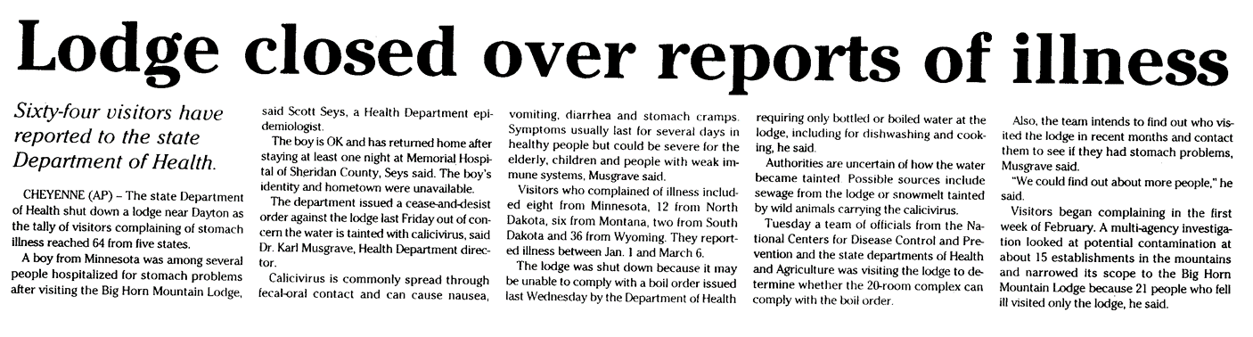

Slide 26
Systems Approach

Slide 27
CS118368

Slide 28
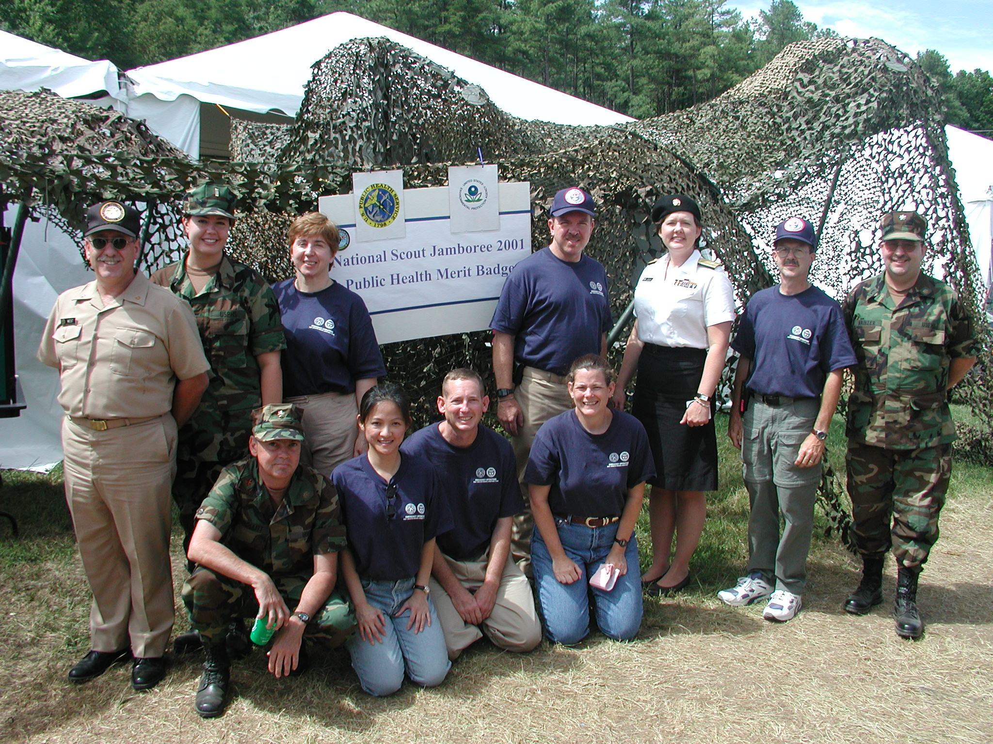

Slide 29
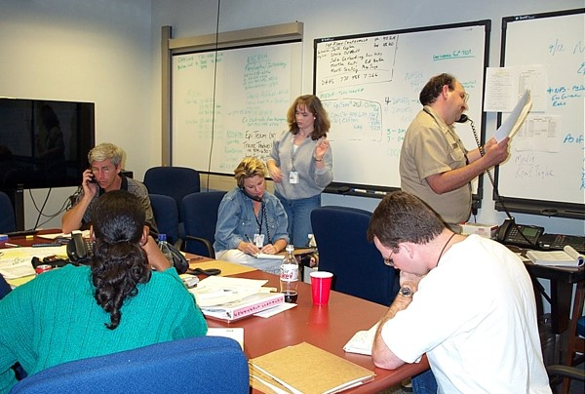

Slide 30
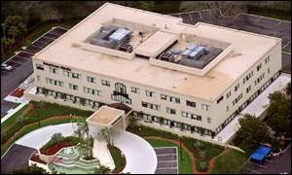

Slide 31



Slide 32





Events impacting large populations that involve CDC/ATSDR
© UNICEF/NYHQ2008-0408/Abramson

Slide 33


Slide 34


Chemical contamination of food
Aqli Foods- Gunma Prefecture - January 2014
Factory worker arrested at a plant that manufactured food adulterated with pesticide (malathion)
Incident led to massive poisoning and a recall of more than 6 million packages of frozen food
More than 2,800 people across Japan may have been sickened by the tainted food

Slide 35








Slide 36
From Health Re-action to Pro-action
“An outbreak or emergency public health response is a resource intense activity… It may reflect either missed opportunities to plan and practice good prevention or an inadequate understanding of the vulnerabilities in a population or in the public health system.”
Hugh Mainzer

Slide 37
A Balanced System of Health Protection
Public Work
Citizen Involvement in Public Life
Societies Health Response
Public Strength
General Protection
Targeted Prevention
Primary Prevention
Secondary Prevention
Tertiary Prevention
Demand For Response
Becoming safer and healthier
Safer Healthier People
Vulnerable People
Afflicted without Complications
Afflicted with Complications
Becoming vulnerable
Becoming afflicted
Developing complications
Adverse Living Conditions
Vulnerable and Afflicted People
Dying from complications
Fraction of Adversity. Vulnerability and Affliction Borne by Disadvantaged Sub-Groups (Inequity)
Social Division
Milstein and Homer, 2003

Slide 38


Image credit: https://time.com ; https://estaticos.efe.com

Slide 39


Slide 40

10 Essential Public Health Services Framework

Slide 41


Slide 42


Slide 43


Thank you for your attention…
HMainzer@cdc.gov

